Slide 1
Economics of CRM
Dr. Swagato Chatterjee
VGSOM IITKGP

Slide 2
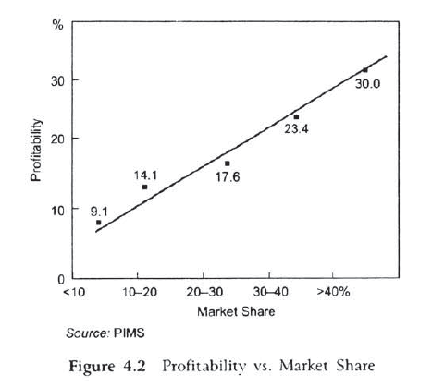
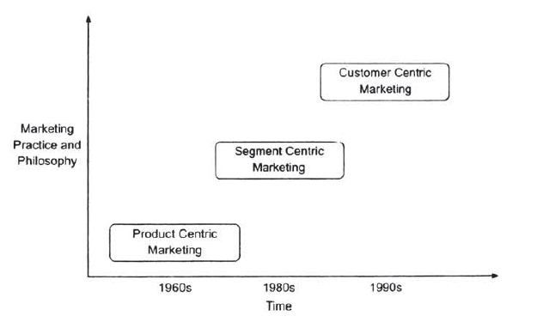

Slide 3
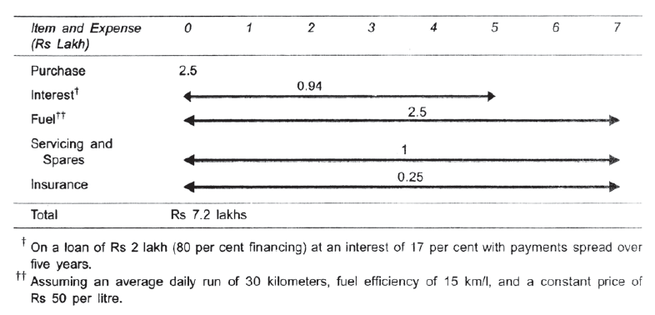
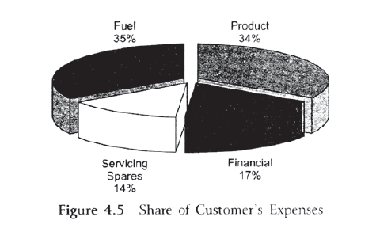

Slide 4
Customer Lifetime Value
CLV
Lifetime
Average Rev per year
Additional sales and service
Referrals generated

Slide 5
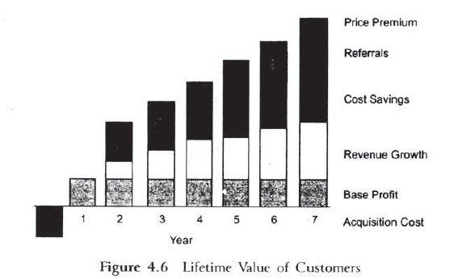

Slide 6
Calculate CLV

